Slide 1
ASSEMBLIES
Advanced Unity

Slide 2
Content
Namespaces
Why we need Assemblies
Assemblies vs Namespaces
How we create them
What is an Assembly
Assembly Definition (ASMDEF)
Assembly Definition Reference (ASMDREF)
Editor and Assemblies

Slide 3
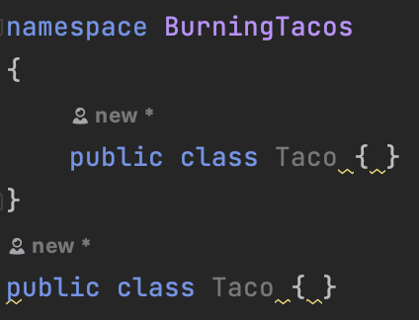
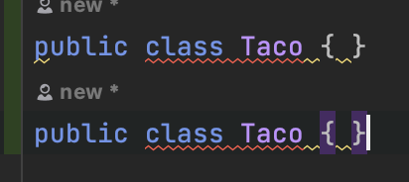
Namespaces
You can have more than one
Organizational purpose
System Boundaries and Dependencies
Allows us to have different…well, names!

Slide 4
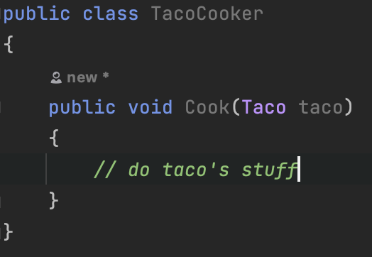
Namespaces
Is this a BurningTaco or just a Taco?

Slide 5
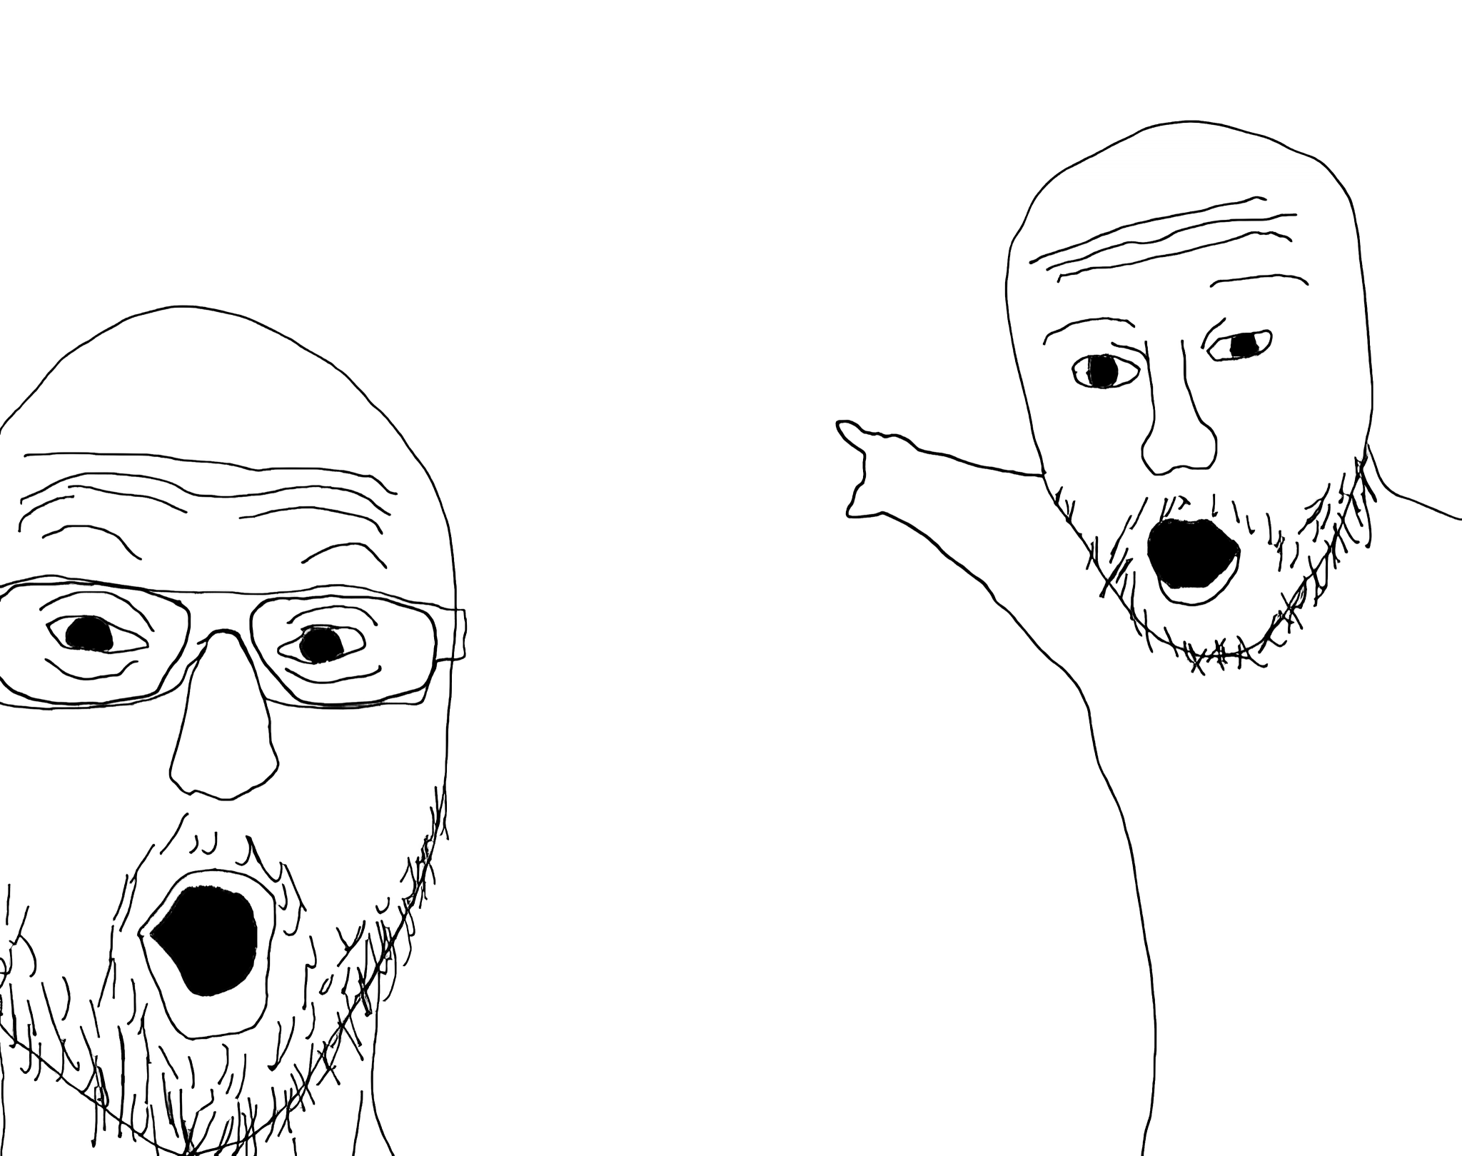
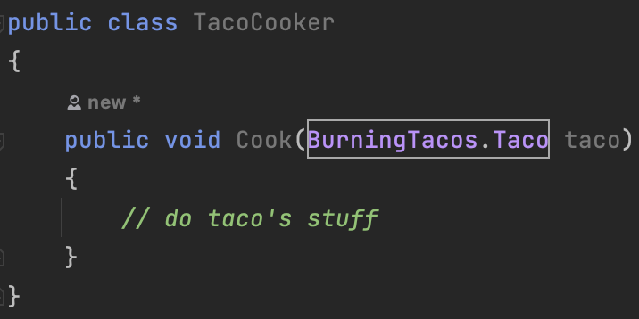
Namespaces
This is NOW definitely a Burning Taco!

Slide 6
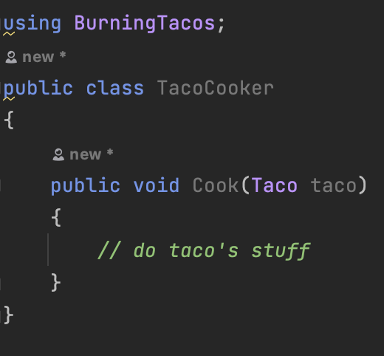
Namespaces
Is this a BurningTaco or just a Taco?

Slide 7
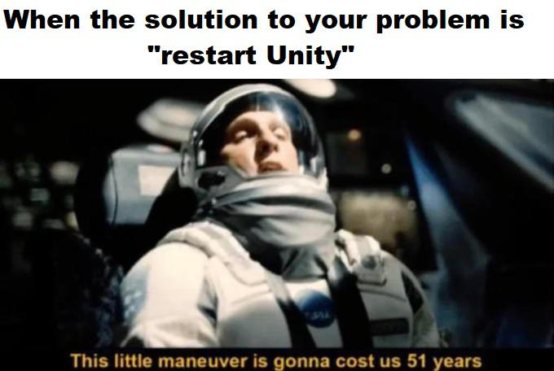
Why we need assemblies
Do you remember namespaces?
All scripts (AND NAMESPACES!) go to a single assembly by default (Assembly-Csharp.dll)
You can have more than one
Organization
System Boundaries and Dependencies
Compilation time

Slide 8

Why we need assemblies
Do you remember namespaces?
All scripts (AND NAMESPACES!) go to a single assembly by default (Assembly-Csharp.dll)
You can have more than one
Organization
System Boundaries and Dependencies
Compilation time

Slide 9
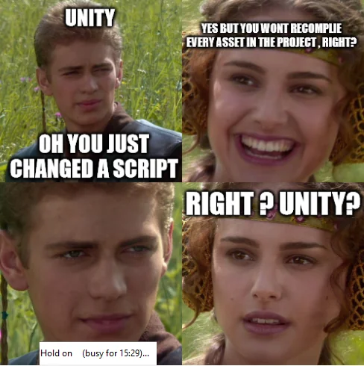
Let’s create our first…
ASSEMBLY!

Slide 10
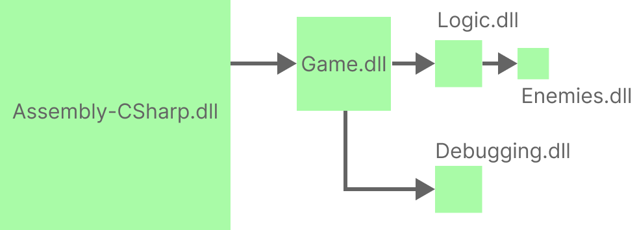
Assemblies vs Namespaces
System Boundaries and Dependencies act on a more restrictive and clear way, depending on project structure
You need to clearly specify the dependencies on those Assemblies

Slide 11
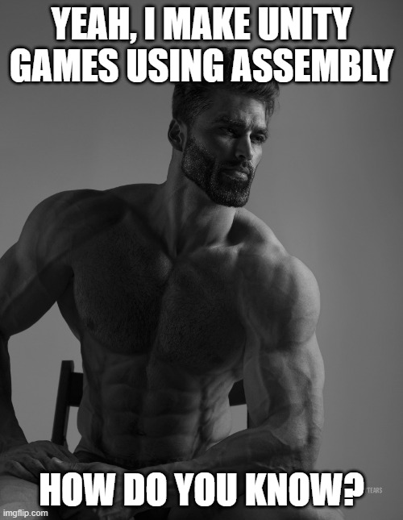
What is an Assembly
An assembly is a C# code library that contains the compiled classes and structs that are defined by your scripts and which also define references to other assemblies.
We have two types of assemblies:
Assembly Definitions (ASMDEF)
Assembly Definition References (ASMDREF)
TLDR; If you are using this one, you’re probably doing something wrong on your architecture!

Slide 12
Editor and Assemblies
You already know that Editor scripts have their own place and restrictions
How we should think with assemblies knowing that restriction?

Slide 13
Let’s try to solve Editor scripts and
ASSEMBLIES!

